Slide 1
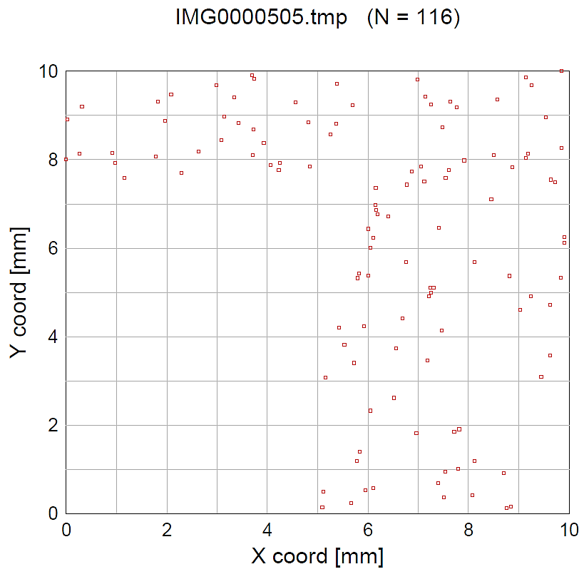
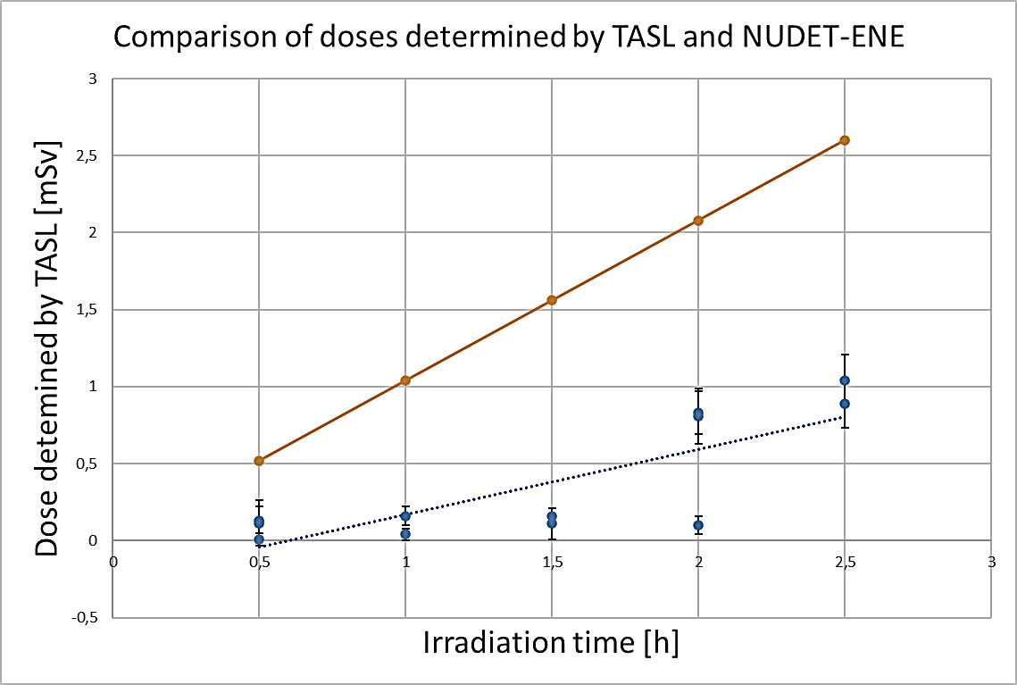
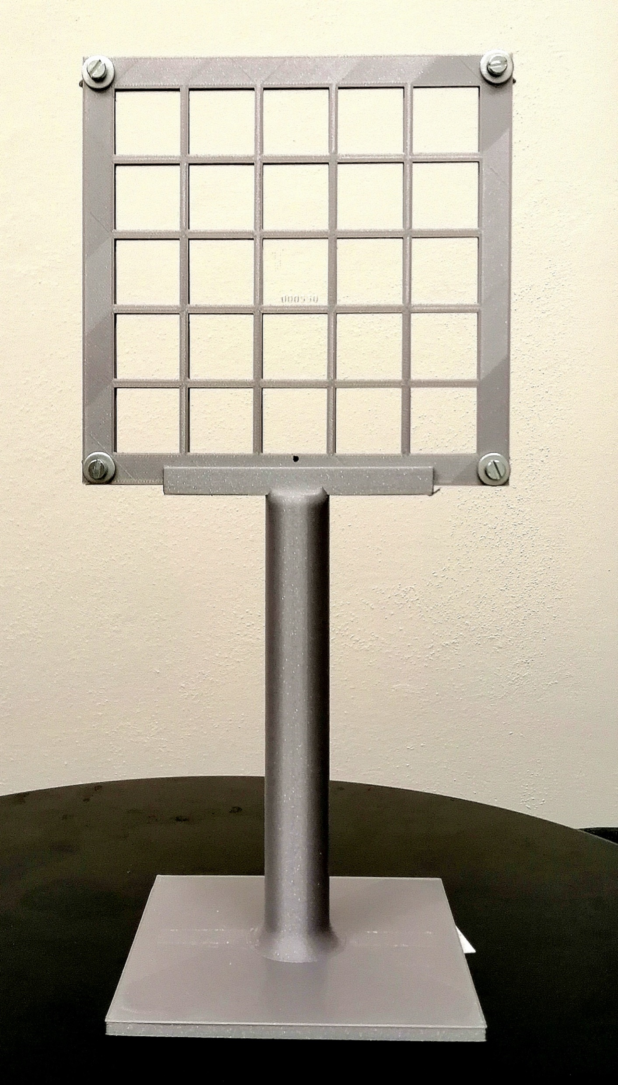
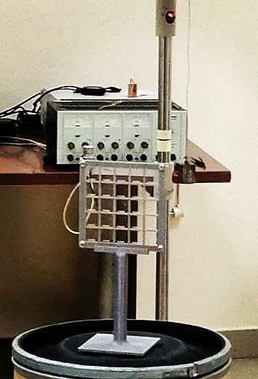
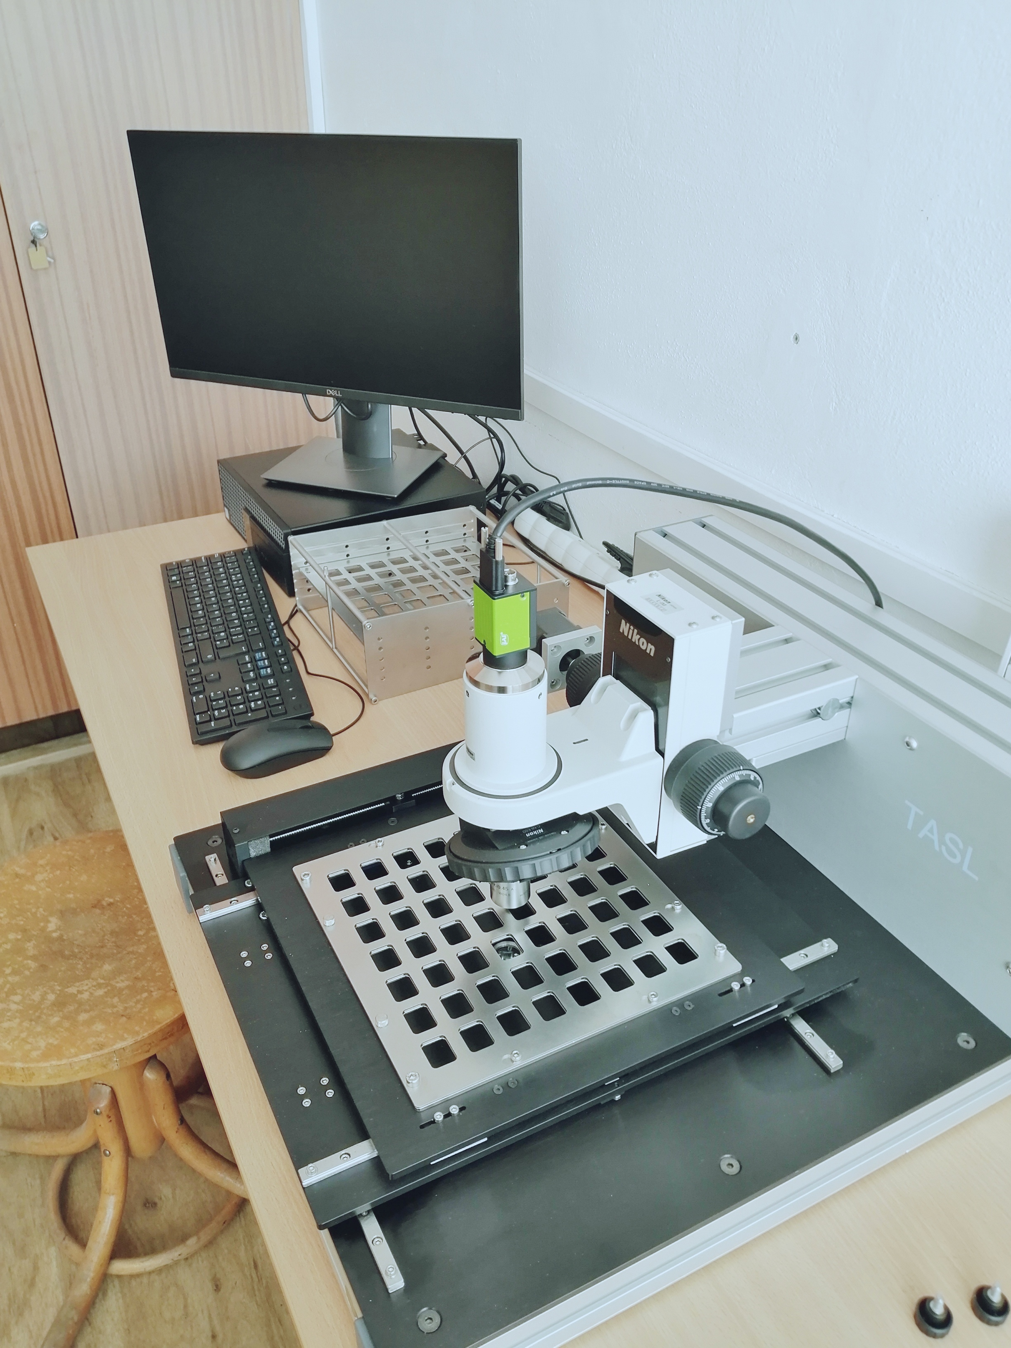
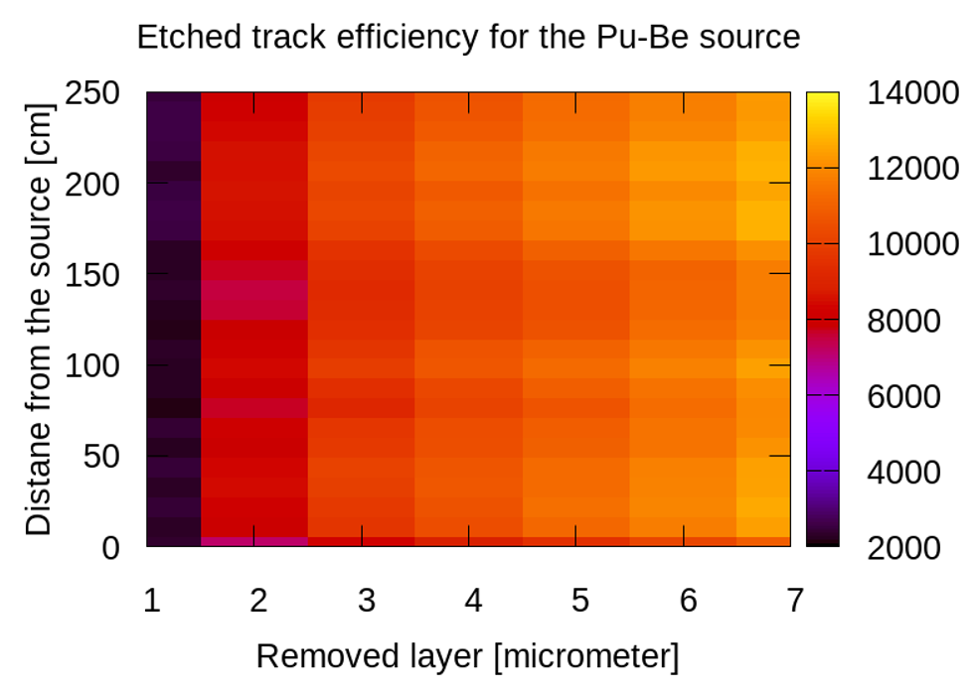
DETERMINATION OF A TASTRACK PLASTIC TRACK DETECTOR RESPONSE TO NEUTRONS FROM THE PU-BE SOURCE
Branislav Vrban, Jakub Lüley, Štefan Čerba, Vladimír Nečas, STU BA
I. MOTIVATION
Several Am-Be and Pu-Be (α,n) neutron sources at INPE.
Precise !n emission rate is ongoing with manganese bath technique.
The performance of different neutron detectors is assessed.
II. SSNTDs
Plastic solid-state detectors (C₁₂H₁₈O₇).
Already applied for neutron and ion particle detection in the past.
Advantages in small size, no need of electronics, simple operation, capability to detect neutrons.
III. EXPERIMENT
First experiment.
TASTRACK™ plastic solid-state detector.
Very low fluences.
²³⁹Pu-Be neutron source, E = 1.06E7 n/s .
Dist. 50 cm, NuDET-ENE H(10) 0.5 Sv/h
Etching 6.25 N 85 °C 2h 50 min.
IV. EXPERIMENT
Irradiation time
30 m; 1 h; 1.5 h; 2 h; 2.5 h.
16 samples; 4 errors.
Automatic internal calibration used.
Track simulation performed.
V. EXPERIMENT
VI. RESULTS
branislav.vrban@stuba.sk

